Slide 1

Bacchus Winery Case Study
Milestone #4 – Group Presentation

Slide 2
Group Introduction
Group: Bacchus Winery Case Study
Team
Members
DJon Harris Scott Johnson Asher Smithson Jackson Webster (partial)
Workflow
Summary
Workflow structured in weekly stages Communication set up early Shared workspace used throughout Weekly alignment maintained
Work
Contribution
Summary
Most tasks completed individually Work merged into the final submission Shared outline shaped the final deliverable

Slide 3
Case Study Overview
Goal
Modernize how operational activity is tracked so decisions can be made with clearer, more accurate information.
Visibility Needed
Gain clearer insight into supplier deliveries, distributor activity, wine movement, and how employee hours are being used.
Expected Outcome
Enable more accurate planning for production, staffing, and marketing through consistent, reliable data.

Slide 4
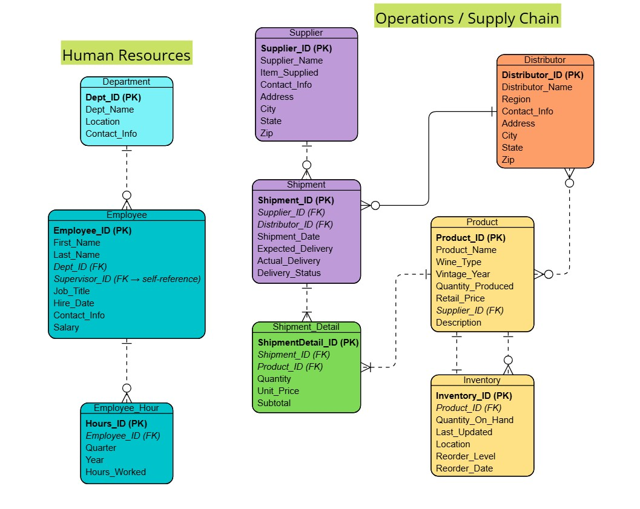
Finalized ERD
This ERD shows how suppliers, shipments, products, distributors, and employee hours connect, providing the structure needed to generate all four reports.
ERD created using Visual Paradigm Online

Slide 5
Report 1: Supplier Delivery Report– How to Interpret
Output Explanation
What the Output Shows
Each row lists a shipment with the supplier’s name, expected delivery date, actual delivery date, and delivery status.
Key Calculations Used
Early/Late Days = Actual_Delivery – Expected_Delivery
“Late” appears when Actual_Delivery > Expected_Delivery
“On-time” appears when the dates match
How to read it
Look for patterns where suppliers repeatedly deliver late or early.
Identify which months show the highest delays.
Compare suppliers to see which ones consistently meet expectations.
Why this matters
This output helps determine supplier reliability, plan production timelines, and adjust ordering schedules.

Slide 6
Supplier Delivery Overview
Goal
See how suppliers perform month-by-month, how often deliveries meet expected dates, and whether any patterns of early or late shipments emerge.
Tables
Supplier → Shipment
Fields
Supplier_Name, Expected_Delivery, Actual_Delivery, Delivery_Status, Shipment_Date
Approach
Calculate early or late delivery days, compare expected and actual dates, and summarize results by supplier and month.
Business Reasons
Identify unreliable suppliers, understand delays that impact production, and adjust ordering schedules or supplier choices as needed.
Report #1: Supplier Delivery Performance

Slide 7
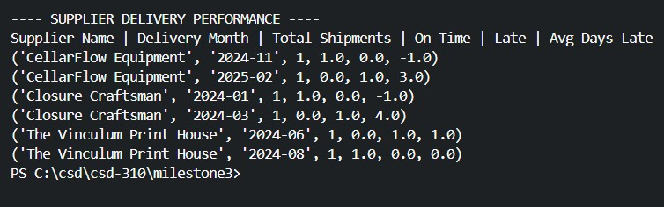
Report 1 – Output Example
Output from report_supplier_delivery.py

Slide 8
Report 2: Wine Distribution & Sales– How to Interpret
Output Explanation
What the Output Shows
Each row lists a wine type, the distributor selling it, quantity sold, total revenue generated, and the quarter of the sale.
Key Calculations Used
Revenue = Quantity_Sold * Unit_Price
Groupings are based on Wine_Type, Distributor_Name, and Quarter.
How to read it
Compare quantities and revenue to see which wines sell the fastest.
Look for distributors that consistently generate higher sales volumes.
Identify which wines underperform or have inconsistent quarterly results.
Examine quarter values to spot seasonal patterns.
Why this matters
This output helps identify top-selling wines, strong-performing distributors, and seasonal demand shifts– supporting production planning, inventory decisions, and distributor strategy.

Slide 9
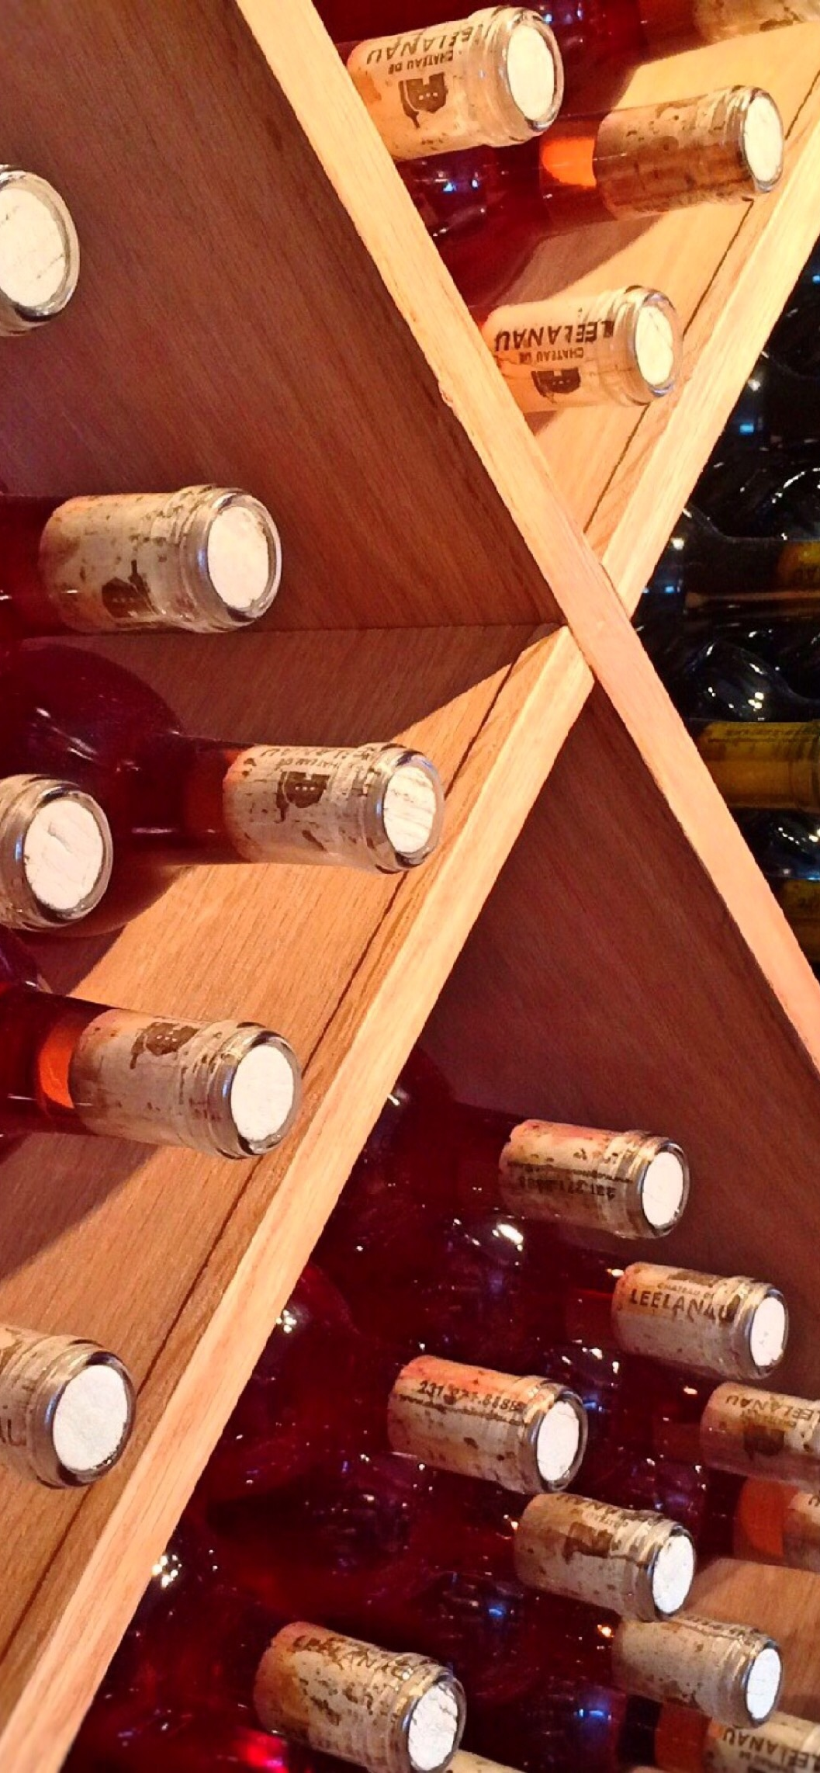
Wine Distribution & Sales Trends
Goal
See which wines sell the fastest, which distributors generate the most movement, and which products underperform.
Tables
Shipment → Shipment_Detail → Product → Distributor
Fields
Wine_Type, Quantity, Unit_Price, Distributor_Name
Approach
Sum quantity and revenue
Group by wine type and distributor
Include optional quarterly grouping
Business reason
Guide production planning, strengthen distributor strategy, and support marketing decisions.
Report #2: Wine Distribution & Sales Report

Slide 10
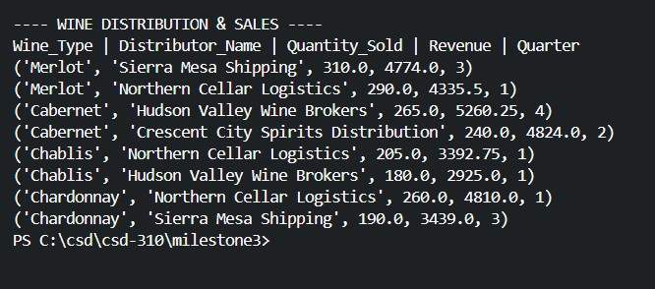
Report 2 – Output Example
Output from report_wine_distribution.py

Slide 11
Report 3: Employee Hours– How to Interpret
What the Output Shows
Each row lists an employee’s name, their department, the year, the quarter, and the total hours worked for that quarter.
The output highlights workload patterns by person and department across the last four quarters.
Key Calculations Used
Total_Hours comes directly from the Employee_Hour table.
Grouping is based on Employee_Name, Dept_Name, Year, and Quarter.
The query filters only the last four quarters in the dataset.
How to read it
Look for employees whose hours consistently increase or decrease, indicating shifting workload.
Compare employees within the same department to spot workload imbalances.
Identify quarter with unusually high or low hours to determine seasonal spikes or underutilization.
Use department trends to evaluate whether staffing aligns with workload needs.
Why this matters
This output helps identify overworked or underutilized employees, informs staffing and payroll planning, and supports decisions about redistributing workload, adding staff, or adjusting schedules.
Output Explanation

Slide 12

Employee Hours by Quarter
Goal
View workload trends across the last four quarters to support staffing and payroll planning.
Tables
Employee_Hour → Employee → Department
Fields
Year, Quarter, Hours_Worked
Approach
Filter for the last four quarters
Sum hours by employee and department
Include an optional pivot view
Business reason
Identify over- and underutilization and guide staffing decisions.
Report #3: Employee Hours Report

Slide 13
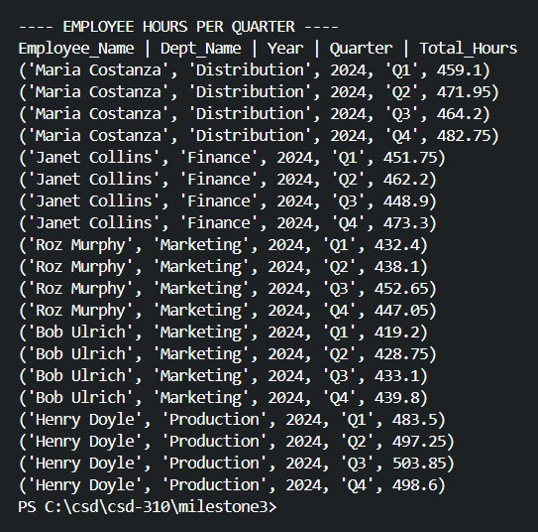
Report 3 – Output Example
Output from report_employee_hours.py

Slide 14
Report 4: Quarterly Sales Trends– How to Interpret
What the Output Shows
Each row lists a quarter, the total units sold across all wines, and the total revenue for that quarter.
This shows the winery’s overall sales volume and revenue patterns over time.
Key Calculations Used
Total_Units_Sold and Total_Revenue come from summing Quantity_Sold and calculating Quantity_Sold * Unit_Price.
Results are grouped at the quarter level only.
How to read it
Compare quarters to see which periods generate higher or lower sales volumes.
Look for quarters with unusually strong or weak revenue to identify seasonal shifts.
Use quarter-over-quarter changes to spot upward or downward sales trends.
Pair these trends with distribution or product insights (Reports 2 & 3) to understand why changes occur.
Why this matters
This output helps track overall business performance, supports seasonal production planning, informs inventory decisions, and highlights periods of rising or slowing demand.
Output Explanation

Slide 15
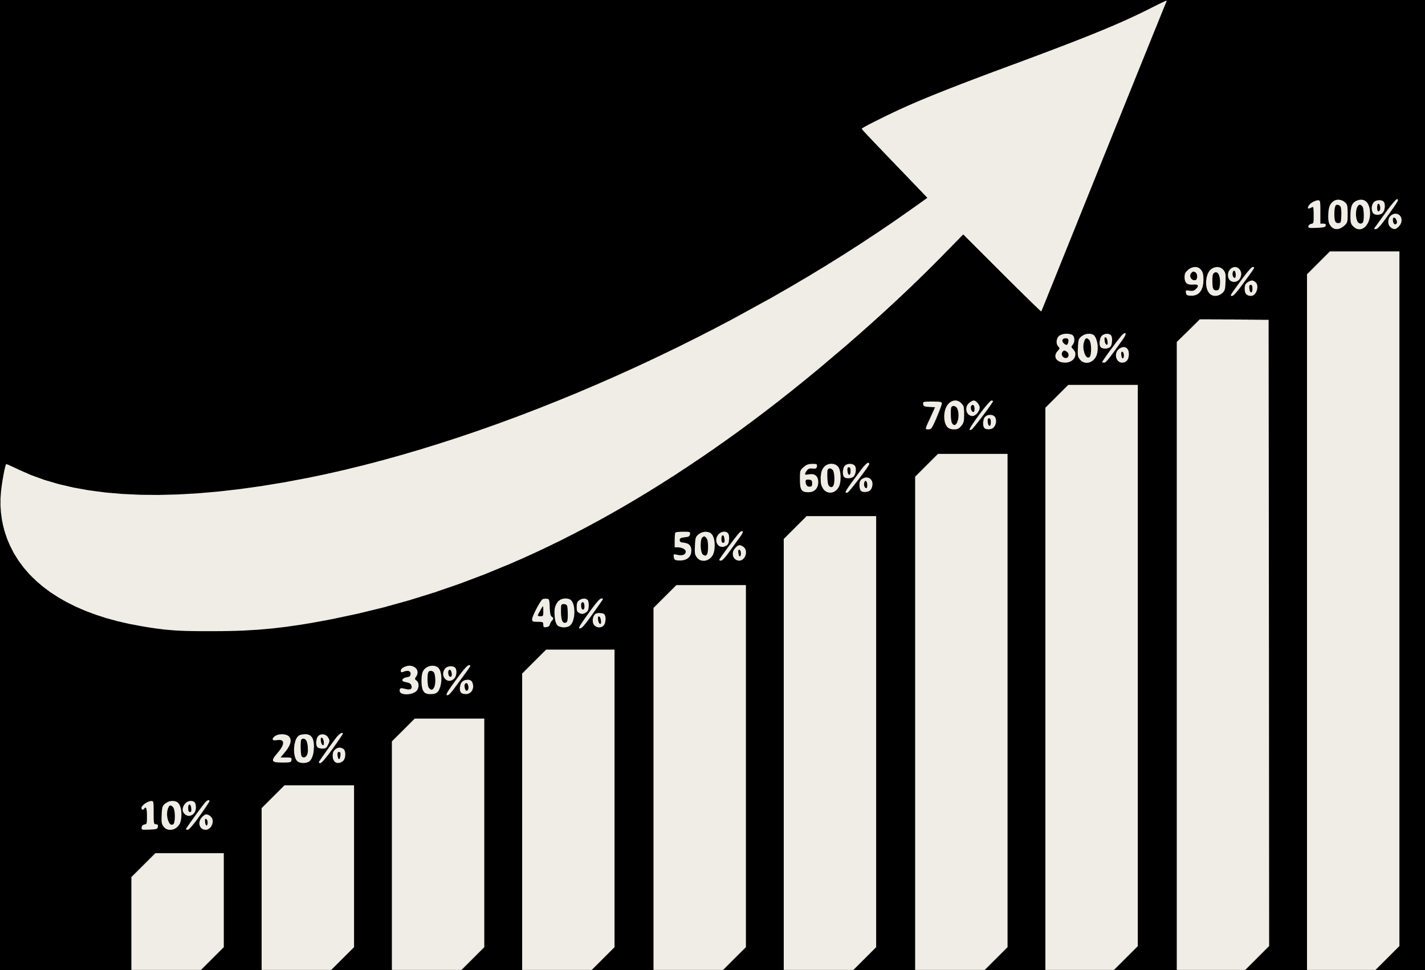
Quarterly Sales Trends
Goal
See how each wine performs quarterly, which products trend upward or slow down, and where sales patterns shift over time.
Tables
Shipment → Shipment_Detail → Product → Distributor
Fields
Wine_Type, Quantity, Unit_Price, Distributor_Name, Quarter
Approach
Sum quantity and revenue
Group results by wine type, distributor, and quarter
Compare quarter-to-quarter changes
Business reason
Support production scheduling, seasonal planning, distributor coordination, and identification of rising or lagging wines.
Report #4: Quarterly Sales Summary

Slide 16
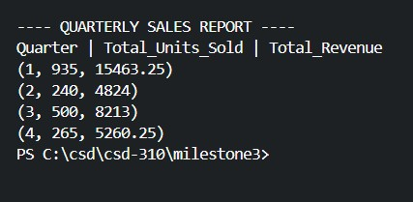
Report 4 – Output Example
Output from report_quarterly_sales.py

Slide 17
How the Python Script Works
What the Script Does:
Connects to the Bacchus Winery MYSQL database
Runs a SQL query for the specific report
Retrieves the results returned by the database
How the Output Is Generated:
Formats each row so it prints clearly in the terminal
Applies grouping or summaries when needed (totals, revenue, or quarter filters)
Displays the final results directly in the console
Why This Matters:
Shows how the data from the ERD is used in each report
Ensures all outputs come from the same consistent SQL logic
Connects the terminal results directly to winery business insights
Script Flow

Slide 18
Python Script Flow Overview
Start
Connect to Database
Execute SQL Query
Format Output for Terminal
Apply Grouping / Summaries
Retrieve Results
Display
Final Output
End

Slide 19
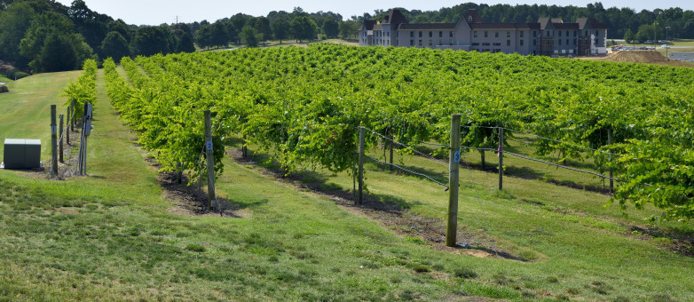
Late Delivery Definition
Actual_Delivery is considered late if it occurs after Expected_Delivery. This defines the rule used to judge supplier timeliness.
Unit_Price Interpretation
Unit_Price in Shipment_Detail is treated as the selling price because cost data is not available. This affects all revenue calculations.
Quarterly Scope
The “last four quarters” refer to the quarters contained in the dataset, not the current calendar year. This prevents confusion when interpreting date ranges.
Data Completeness
Distributors are assumed to sell all SKUs they receive, and Employee_Hour records are assumed complete. This avoids issues caused by partial shipments or missing time entries.
ERD Structure
The ERD is maintained in 3NF, and reorder levels are optional. This clarifies the database design and why certain fields may not appear.
Assumptions

Slide 20
Summary
The ERD provides the structure needed to evaluate supplier reliability, product movement, and staffing trends.
The four reports reveal patterns in delivery timing, wine distribution performance, quarterly sales changes, and employee workload.
These insights support stronger planning across production, distribution, and resource management.
Next Steps
Review supplier performance monthly to stay ahead of delivery issues.
Adjust production or distributor strategy based on wine sales and quarterly trends.
Revisit staffing distribution each quarter to prevent overload and maintain workflow balance.
Continue refining the reporting process as new data becomes available.

Slide 21
Questions?

